Slide 1

RELATIVE RISK ESTIMATION IN RANDOMISED CONTROLLED TRIALS:
A COMPARISON OF METHODS FOR INDEPENDENT OBSERVATIONS
Lisa N Yelland, Amy B Salter, Philip Ryan
The University of Adelaide, Adelaide, Australia
Notes:
Intro by chair: Lisa Yelland is a second year PhD student from the University of Adelaide in Australia. Her research focuses on statistical issues associated with binary outcomes in randomised controlled trials and today she will be talking about relative risk estimation.
Today I will be presenting the results of a simulation study I conducted to compare different methods for estimating relative risk in the context of randomised controlled trials or rcts with independent data.

Slide 2
Background
Binary outcomes traditionally analysed using logistic regression
Effect of treatment described as odds ratio
Odds ratio difficult to interpret
Often misinterpreted as relative risk which will overstate treatment effect
Notes:
Firstly to give you some background to the problem, binary outcomes have traditionally been analysed using logistic regression models. In the context of rcts, logistic regression can be used to estimate the effect of treatment on a binary outcome while controlling for both categorical and continuous baseline covariates and this treatment effect will be expressed as an odds ratio. There has been quite a bit of discussion in the literature about the usefulness of odds ratios given that they are difficult to interpret and are often misinterpreted as relative risks in which case the effect of treatment will be overstated.

Slide 3
Example
US study* on effect of patient race on physician referrals
Referral rate: white 90.6% vs black 84.7%
Reported odds ratio of 0.6
Interpreted by media as referral rates 40% lower for black vs white
Relative risk is actually 0.93**
References: * Schulman et al. NEJM 1999; 340: 618-626.
** Schwartz et al. NEJM 1999; 341: 279-283
Notes:
As an example of what can go wrong when odds ratios are misinterpreted, there is a rather famous study conducted in the US which looked at the effect of race on whether physicians recommended referring patients who presented with chest pain for cardiac catheterisation. The study found that the referral rate was 90.6% for white patients compared to 84.7% for black patients and the odds ratio of 0.6 was reported. This study generated quite a bit of interest from the media who went on to say that referral rates were 40% lower for black patients compared to white patients and you can just imagine the kind of response a headline like this would receive. In other words, the media interpreted the odds ratio as a relative risk. The actual relative risk was 0.93 which indicates that referral rates were only 7% lower for black patients compared to white patients. By incorrectly interpreting the odds ratio as a relative risk, this effect of race was severely overstated in the media.

Slide 4
Relative Risks
Growing preference for relative risk
Log binomial regression recommended
Generalised linear model
Convergence problems common
Notes:
Because of these problems with odds ratios, many people are now arguing that relative risks should be used instead of odds ratios. This approach is also being adopted in practice, with relative risks being reported in many recent rcts. In order to estimate relative risks, log binomial regression has been recommended. The log binomial regression model is simply a generalised linear model which assumes a binomial error distribution, just like logistic regression, however instead of using a logit link it uses a log link. Unfortunately, the log binomial model is prone to convergence problems.

Slide 5
Relative Risks
Growing preference for relative risk
Log binomial regression recommended
Generalised linear model
Convergence problems common
p_{i} = exp(β₀ + β₁x_{1i} + …)
Notes:
To understand why this occurs, it helps to have a look at the log binomial regression model expressed in this way – this formula says that the probability of experiencing the outcome for subject i is given by exponentiating the linear predictor.

Slide 6
Relative Risks
Growing preference for relative risk
Log binomial regression recommended
Generalised linear model
Convergence problems common
p_{i} = exp(β₀ + β₁x_{1i} + …)
(0,1)
Notes:
Now on the left hand side we have a probability so this must lie in the (0,1) interval.

Slide 7
Relative Risks
Growing preference for relative risk
Log binomial regression recommended
Generalised linear model
Convergence problems common
p_{i} = exp(β₀ + β₁x_{1i} + …)
(0,1)
>0
Notes:
But on the right hand side, the value is only constrained to be positive since there are no constraints on the model parameters which are the betas here. It is this mismatch that leads to convergence problems with the model.

Slide 8
Alternative Methods
Many different methods proposed
Few comparisons between methods
Unclear which method is ‘best’
Further research is needed
Notes:
Because of these convergence problems with the log binomial model, many different methods have been proposed for estimating relative risk, however very few comparisons have been made between the methods so it is currently unclear which approach should be used in practice. This suggests that further research is needed in this area.

Slide 9
Aim
To determine how the different methods for estimating relative risk compare under a wide range of scenarios relevant to RCTs with independent observations
Notes:
This brings me to the aim of my research which was to determine how the different methods for estimating relative risk compare under a wide range of scenarios. I chose to focus specifically on the context of RCTs with independent observations. I chose to focus on rcts so I could do a more in depth study of this particular setting and because most of the work I have done has been in rcts and it is the area I am most interested in.

Slide 10
Methods
Log binomial regression
Constrained log binomial regression
COPY 1000 method
Expanded logistic GEE
Log Poisson GEE
Log normal GEE
Logistic regression with
  marginal or conditional standardisation
  delta method or bootstrapping
Notes:
I considered 10 different methods for estimating the relative risk which I have listed here, each of which allows you to adjust for both categorical and continuous covariates. Unfortunately I don’t have time to explain each of these methods in detail but I will run through them quickly just to give you the general idea. First we have the log binomial regression model which I have talked about already. I used this for comparison because it has been recommended and is kind of the obvious choice for estimating relative risks. Next is the constrained log binomial regression model which constrains the estimation process to try and avoid convergence problems. The next 2 methods are the copy 1000 method and the expanded logistic gee. Both of these methods involve analysing a modified dataset which still lets you estimate the relative risk but hopefully without the convergence problems. Next we have the log poisson gee and the log normal gee. The idea here is to fit a generalised linear model, still using the log link but with a different error distribution instead of the binomial error distribution. Since this can lead to problems with standard errors, robust variance estimation is needed to account for the fact that an incorrect error distribution is assumed which can be achieved using generalised estimating equations or gees. Finally, I looked at 4 methods based on fitting a logistic regression model which is not prone to convergence problems. The results can be used to come up with a standardised estimate of the relative risk and I considered both marginal and conditional standardisation. In order to calculate a confidence interval for the relative risk, I considered both the delta method and bootstrapping.

Slide 11
Simulation Scenarios
Simulated data assuming log binomial model
170 simulation scenarios
  200 or 500 subjects
  Blocked or stratified randomisation
  Different treatment and covariate effects
  Binary and/or continuous covariate
  Different covariate distributions
Notes:
In order to compare these methods, I conducted a large simulation study. I simulated data assuming a log binomial model. I looked at 170 different simulation scenarios with a total sample size of 200 or 500 subjects, where blocked or stratified randomisation was used to assign subjects to treatment groups, I considered a range of treatment and covariate effects, both binary and continuous covariates and different distributions for those covariates.

Slide 12
Size of Study
1000 datasets per scenario
10 different methods
2000 resamples used for bootstrapping
Unadjusted and adjusted analyses
SAS grid computing
Notes:
For each simulation scenario, I generated 1000 datasets and each dataset was analysed using each of the 10 different methods. I used 2000 resamples for the 2 methods which used bootstrapping to determine the confidence intervals. I also performed both unadjusted and adjusted analyses. Given the size of the simulation study, it’s not surprising that I had a few computational difficulties setting this up. I ended up using something called grid computing in SAS in order to get the simulations to run in a reasonable amount of time.

Slide 13
SAS Grid Computing
Run SAS program
Task
Result
Combined Results
Notes:
The basic idea with grid computing in SAS is that you connect a bunch of computers up in a grid and then you run a program on one computer which will then distribute tasks to all computers in the grid and these run in parallel, allowing you to get the results much faster.

Slide 14
Comparing Methods
Comparisons based on:
  Convergence
  Type I error
  Power
  Bias
  Coverage probability
Notes:
I compared the different methods for estimating relative risk based on a number of statistical properties including whether the model converged, whether the type I error rate differed significantly from the nominal level, the power to detect a treatment effect, the bias in the estimated relative risk and whether the coverage probability differed significantly from the nominal level.

Slide 15
Results - Overall
Differences between methods
Convergence problems
Differences in type I error rates and coverage probabilities
Large bias for some methods under certain conditions
Little difference in power
Notes:
Onto the results now. Overall, I found that there were differences between the methods in terms of the different statistical properties I looked at. There were convergence problems with log binomial regression in some scenarios as might be expected but interestingly some of the alternative methods also failed to converge in some cases. I also found that some methods were more prone to having problems with type I error rates or coverage probabilities in the sense that the observed value differed significantly from the nominal level. Some methods produced large biases under certain conditions. The methods generally could not be differentiated based on power.

Slide 16
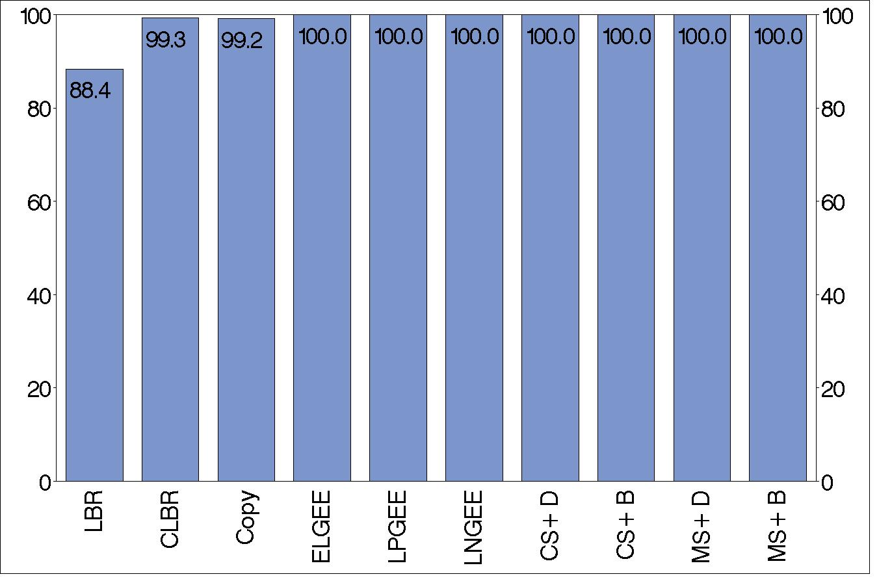
Results - Convergence
Percentage of Simulations where Model Converged
%
Method
Notes:
To give you some specific examples of what I found, here is a plot showing the convergence rates for one of the simulation scenarios I looked at. You can see that the method on the left, log binomial regression, only converged about 88% of the time. The next 2 methods which were the constrained log binomial regression and the copy method occasionally suffered from convergence problems, while the remaining methods always converged. This pattern occurred for many of the scenarios I looked at.

Slide 17
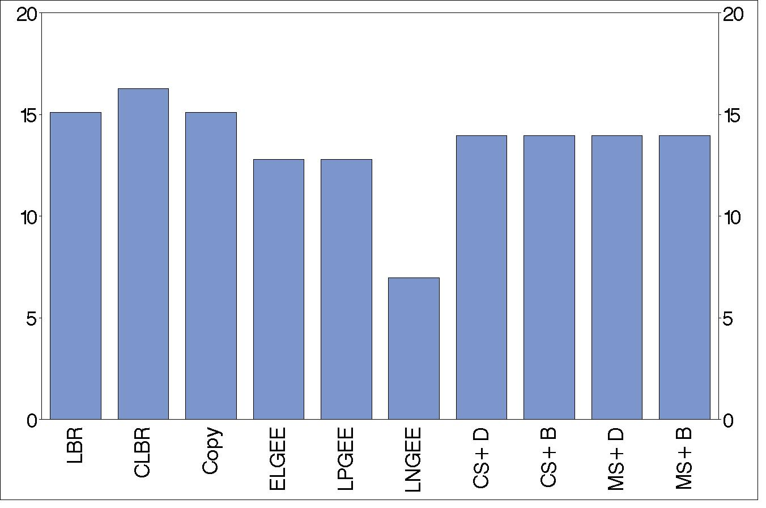
Results – Type I Error
Percentage of Simulation Scenarios where Type I Error Problems Occurred
%
Method
Notes:
This plot shows the percentage of scenarios where the type I error rate differed significantly from the nominal level out of the scenarios I looked at when treatment had no effect. Here we see that most methods performed similarly, with one standing out as the winner – this was the log normal gee. I should point out that this method had some other problems with it so this is not necessarily the best method to use overall.

Slide 18
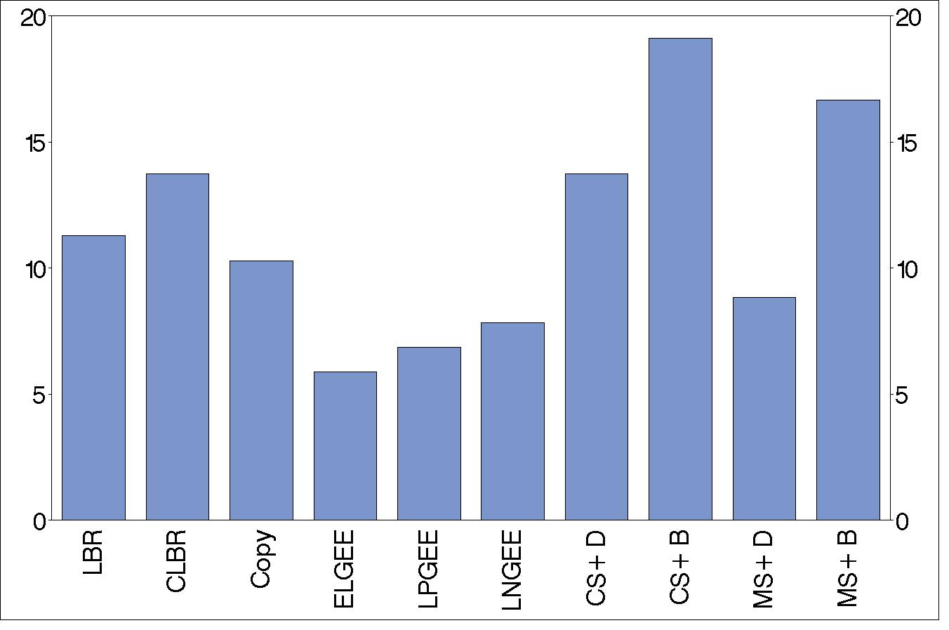
Results – Coverage
Percentage of Simulation Scenarios where Coverage Problems Occurred
%
Method
Notes:
This plot shows the percentage of scenarios where the coverage probability differed significantly from the nominal level out of all the scenarios I considered. Here we see that the methods varied considerably, ranging between about 6% and 19%, with the GEE methods performing best.

Slide 19
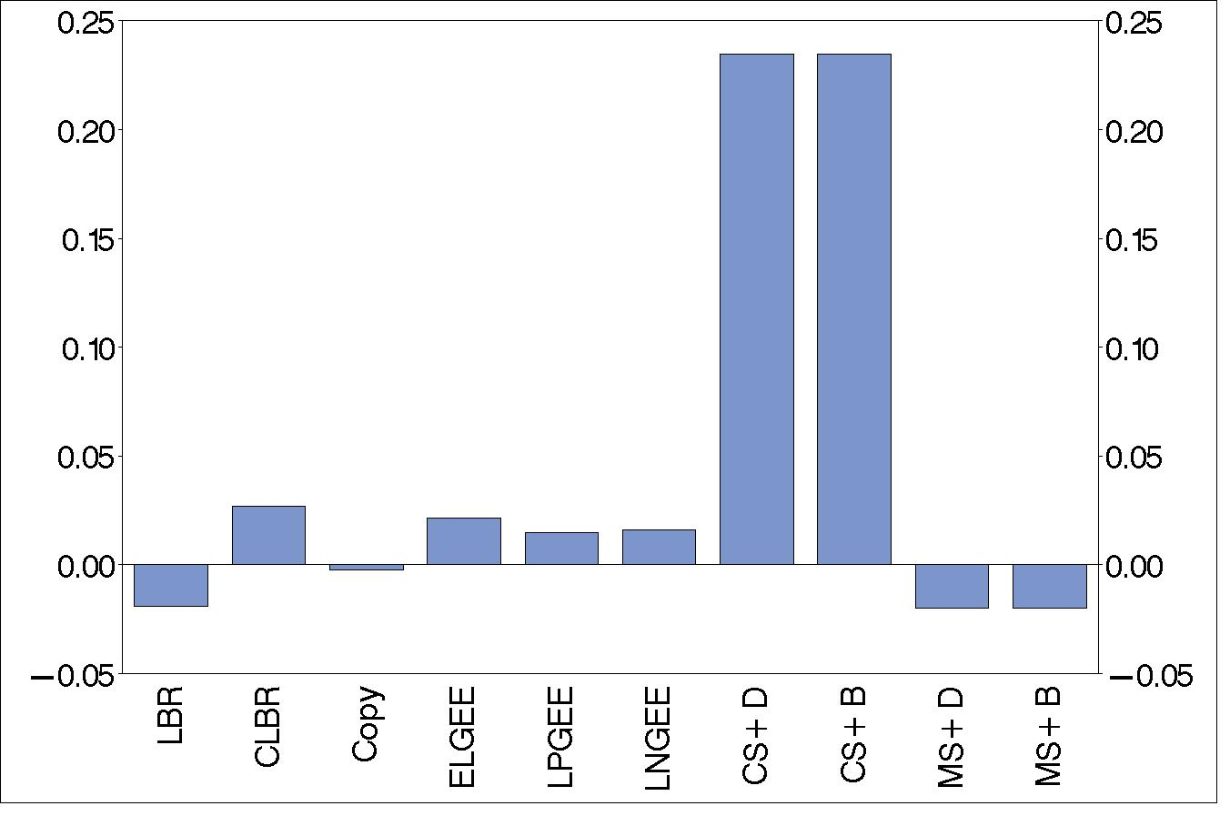
Results – Bias
Median Bias in Estimated Relative Risk
Bias
Method
Notes:
This plot shows the median bias in the estimated relative risk for one of the simulation scenarios I looked at when the true relative risk was 2. You can see that the bias is quite small for most methods but the 2 methods based on fitting a logistic regression model and then using conditional standardisation to estimate the relative risk had quite a large positive bias. This problem with bias for these methods occurred in scenarios where both the treatment and covariate effects were large.

Slide 20
The Winner
Log Poisson approach
Performed well relative to other methods
Simple to implement
Most used in practice
Invalid predicted probabilities (max 6%)
Problematic if prediction is of interest
Notes:
Based on the results of the simulation study, I would recommend using the log poisson approach to estimate the relative risk when the log binomial model fails to converge. Just to remind you, this approach involves fitting a generalised linear model with a log link where the binomial error distribution is replaced by a poisson error distribution and robust variance estimation is needed to obtain appropriate standard errors which can be obtained using gees. I found that this method performed well relative to other methods considered in the simulation study and it is also easy to implement. Interestingly, this method is the one that appears to be most commonly used in practice, presumably because of its simplicity. The only real problem with this method is that it can produce invalid predicted probabilities for some patients , or in other words, predicted probabilities greater than 1. In my simulations, I found that this happened for between 0 and 6% of patients. To some people, this is a major downfall. I would say that it is probably not a big deal in the context of rcts where the focus is typically on the overall relative risk comparing treatment to control. However, it could certainly be problematic if the model was also intended for prediction, in which case one of the approaches which does not allow invalid probabilities might be preferable.

Slide 21
Conclusion
Log binomial regression useful when it converges
Many alternatives available if it doesn’t
Alternatives not all equal
Log Poisson approach recommended if log binomial regression fails to converge
Performance with clustered data remains to be investigated
Notes:
In conclusion, log binomial regression is a useful approach for estimating relative risks when the model converges and there are many alternative methods available for when it doesn’t converge. Based on my simulation study comparing these methods in the context of rcts with independent data, I found differences between these methods in terms of performance and I would recommend the log poisson approach for use in practice when log binomial regression fails to converge. The next step is to look at how this and other methods perform in the context of clustered data, for instance in cluster randomised trials, and this is something I am currently investigating.

Slide 22
Acknowledgements
International Biometric Society for financial assistance sponsored by CSIRO
Professor Philip Ryan and Dr Amy Salter for supervising my research
Notes:
Finally I would just like to acknowledge the international biometric society for providing me with financial assistance to attend this conference through the generous sponsorship provided by CSIRO and also my supervisors, professor philip ryan and dr amy salter at the university of adelaide for supervising this work.

Slide 23
Questions?

